Slide 1
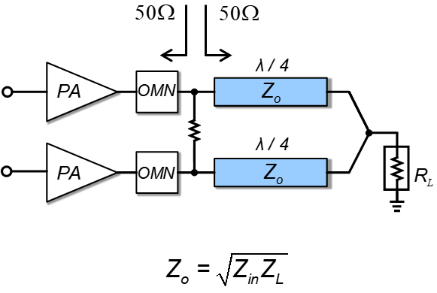
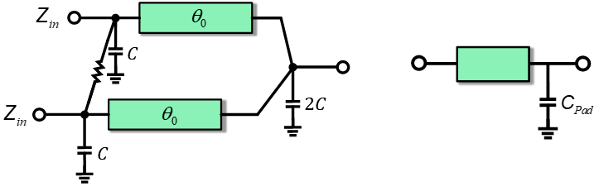
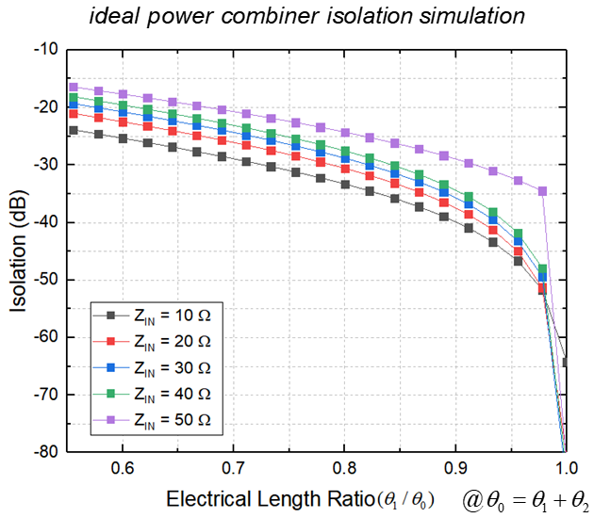
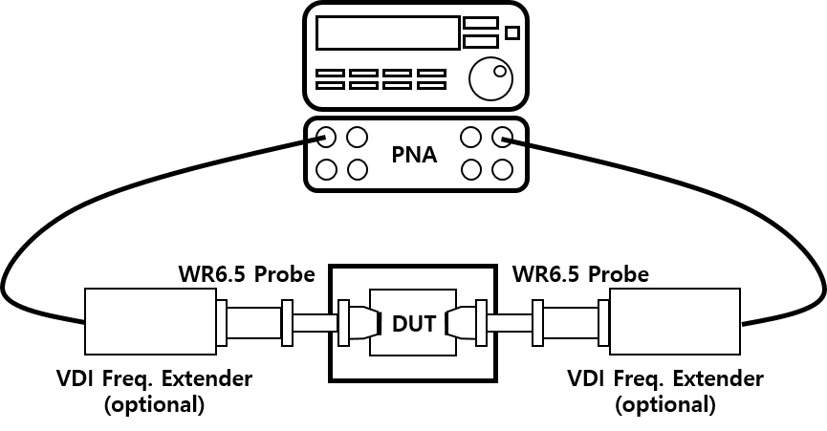
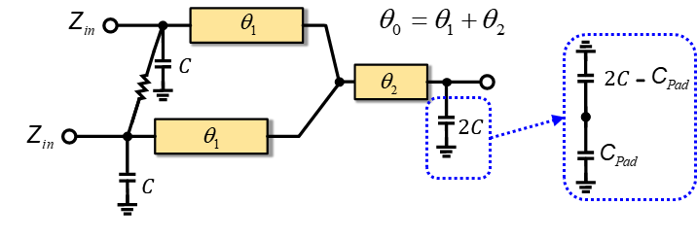
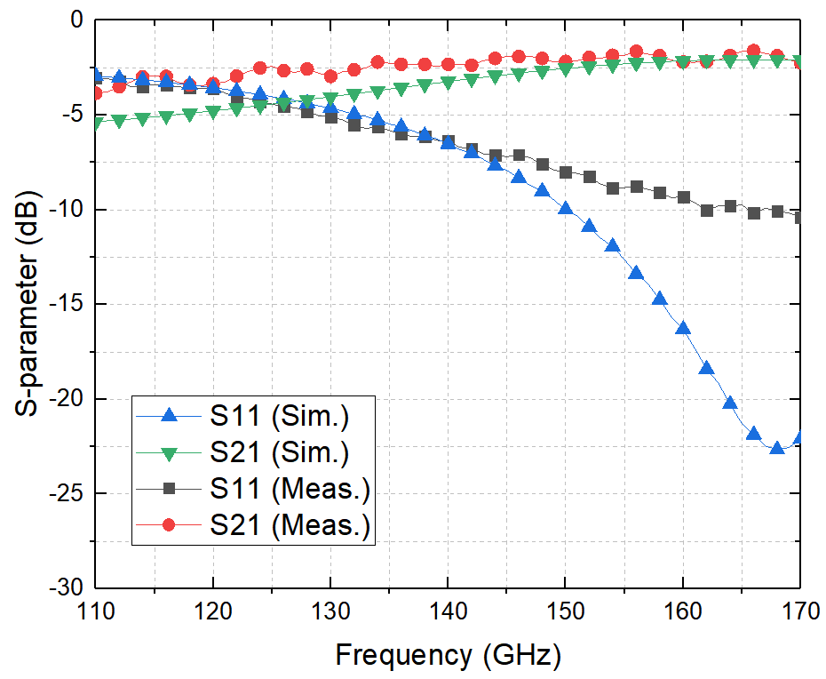
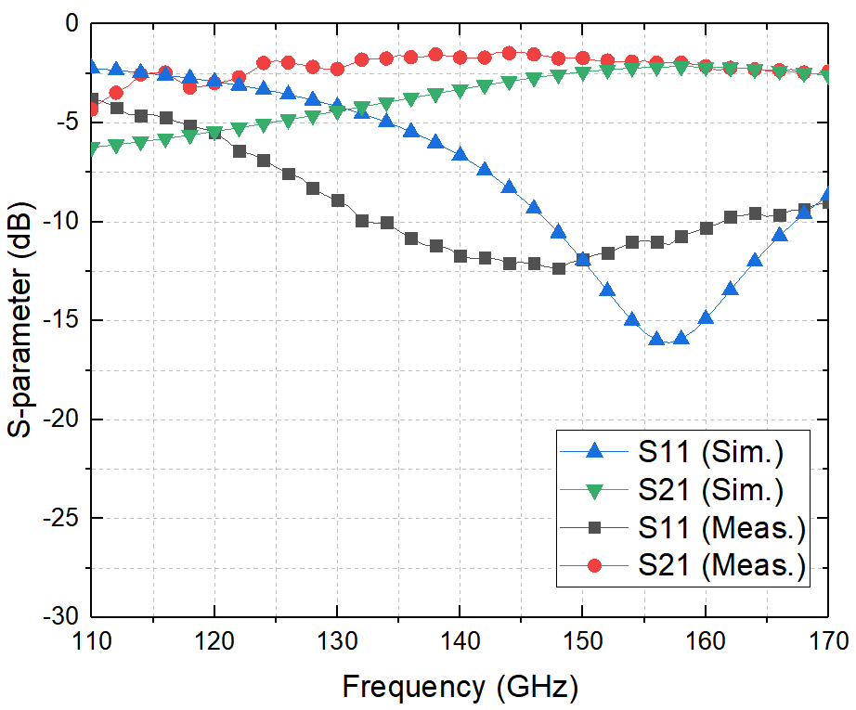
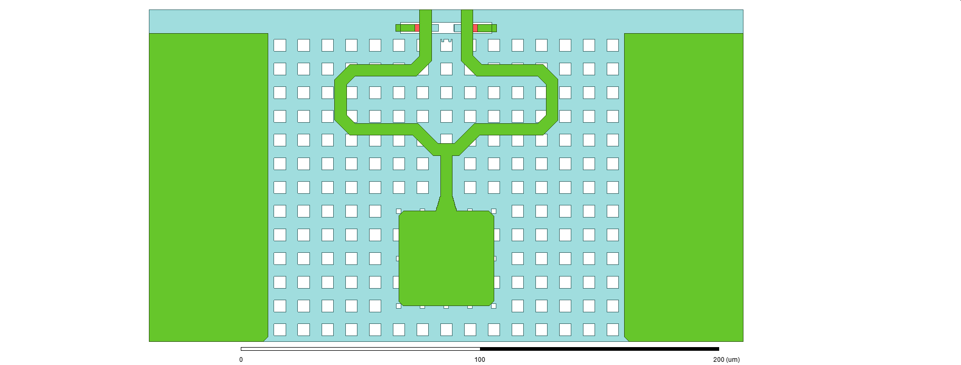
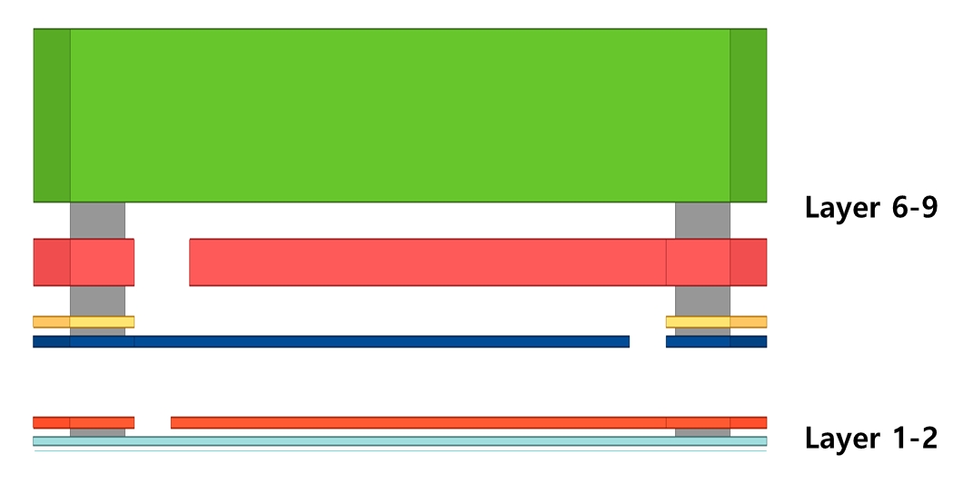
D-band CMOS Power Combiner using RF Pad Characteristics
Ui-Gyu Choi°, Dong-Jun Shin, Ji-In Jung, Hyeon-Jin Son, JuHyeon Park, Jong-Ryul Yang*
Electronic engineering, Yeungnam University
E-mail: °ugchoi@yu.ac.kr , *jryang@yu.ac.kr
Background
A power combiner is an important passive device to overcome the limitation of output power in millimeter-wave transmitters.
A Wilkinson power combiner is widely used to combine output power of each power amplifier (PA) with high isolation between two input ports. However, an additional matching network is required in the power combining architecture using the conventional WPC because an output impedance of the PA, which is optimized at a low impedance for increasing output power, should be transformed to the reference impedance.
In this project, a compact and low-loss power combiner which have both the output combining and impedance matching of the transmitter in the D-band is proposed.
Methods
Results
A Conventional Wilkinson Power Combiner
Chip micrograph of the back-to-back test structure
Good isolation and asymmetry
Bulky and bandwidth limitation
High loss and skinny line
Works only with 50ohm cells
A Proposed Power Combiner
Z_{in} = 10
Z_{in} = 20
Z_{in} = 50
Area (mm²) | Z_{in} = 10 | Z_{in} = 20 | Z_{in} = 50
w. pad | 0.0375 (0.0093 𝜆₀²) | 0.035 (0.0087 𝜆₀²) | 0.038 (0.0096 𝜆₀²)
w/o pad | 0.012 (0.003 𝜆₀²) | 0.007 (0.0017 𝜆₀²) | 0.013 (0.0031 𝜆₀²)
Ideal power combiner isolation simulation
Measurement Results
Conventional Power Combiner Network
Pad Network
Minimum Insertion Loss
Z_{in} = 10
< -0.71 dB
Z_{in} = 20
< -0.80 dB
Z_{in} = 50
< -1.21 dB
Proposed Power Combiner Network
<Measurement Setup>
Cross Section Of The Proposed Power Combiner.
Z_{L}
G
2C
S
G
TSMC 65 nm GP Process 1P9M
Z_{in} = 10
Z_{in} = 20
Z_{in} = 50
TL₂
<S-parameter Results>
TL₁
TL₁
Conclusion
C
2R_{IN}
C
M9
Pad MIM capacitor
A compact size and low loss power combiner using a RF pad characteristics is proposed for the D-band high power transmitter
Z_{IN}
Z_{IN}
M1
Size reduction and low loss by merging the pad network
< Acknowledge >
No additional Calibration required
This work was supported by NRF grant funded by MSIT (No. 2021R1A2C2004356)
The chip fabrication and EDA tool were partially supported by IDEC, Korea.

